Slide 1

HEART DISEASE PREDICTION
BY:
Munna Manish Balaji
SaiKrishna Thiwakar R.K
Mohammed Ayaan.A

Slide 2
INDEX
PROBLEM STATEMENT
PROPOSED SYSTEM
SYSTEM DESIGN
EXPERIMENTAL SETUP
MODEL IMPLEMENTATION
CONCLUSION

Slide 3
PROBLEM STATEMENT
Many patients require continuous monitoring of various parameters, which can be expensive and cumbersome.
Often the medical history of the patient is not readily available or compiled .
Many lives can be saved if Heart Disease is predicted using its early symptoms.

Slide 4
PROPOSED SYSTEM
We have proposed a system which will attempt to solve the above-mentioned problems. Sensors can be used to capture the vitals of the patients.
We expect that, using these vitals and the medical history, the Logistic Regression along with K-Nearest Neighbors algorithm will efficiently predict Heart Disease.

Slide 5
RESEARCH METHODOLOGY
LOGISTIC REGRESSION, K-NEAREST NEIGHBORS ALGORITHMS
SOURCE OF DATA
DATA EXPLORATION

Slide 6
ALGORITHM
Logistic regression is a statistical model that in its basic form uses a logistic function to model a binary dependent variable, although many more complex extensions exist.
The K-nearest neighbors (kNN) algorithm is a machine learning algorithm that uses a set of training data to classify or predict new data points

Slide 7
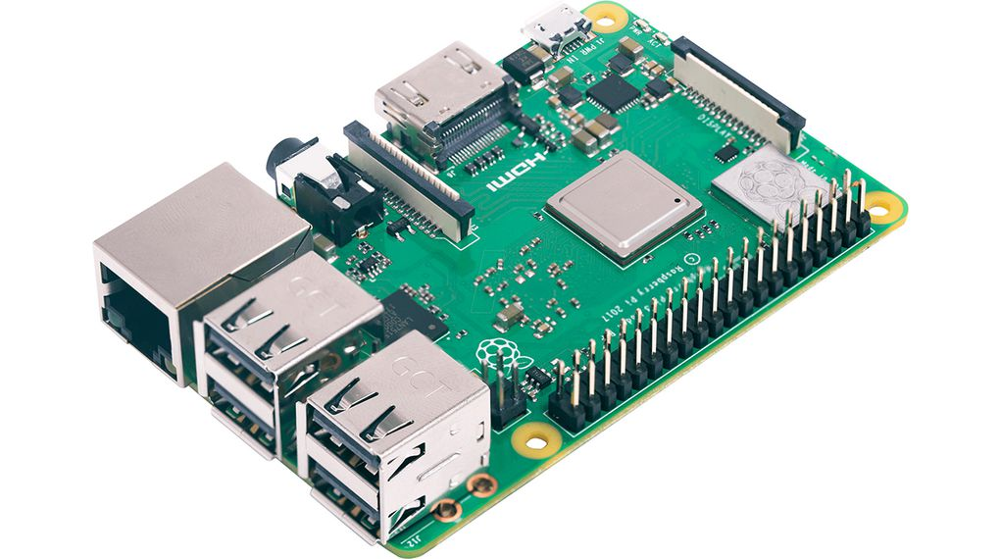
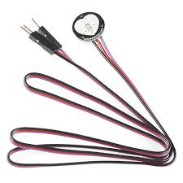
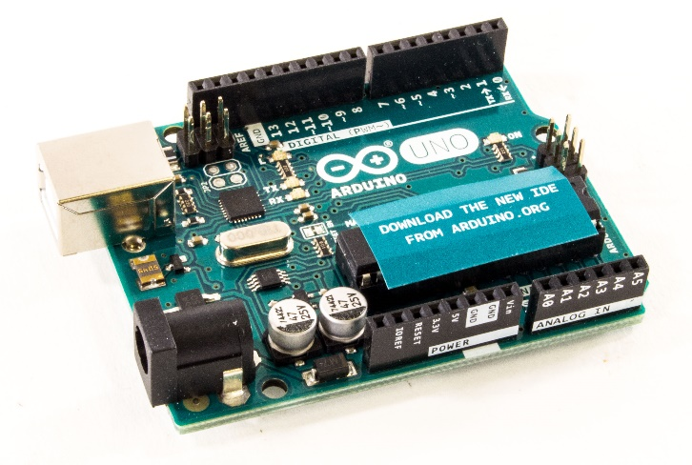
SYSTEM DESIGN

Slide 8
EXPERIMENTAL SETUP
The basic experimental setup consisted of Ardunio, heart/pulse rate sensor, a laptop to display the output of the sensor.The whole process is divided into 2 parts which are:
ARDUNIO.
HEART/PULSE RATE SENSOR PART.
ARDUNIO PART.
HEART/PULSE RATE SENSOR PART:
The sensors were connected to the Arduino using a Node Head.

Slide 9
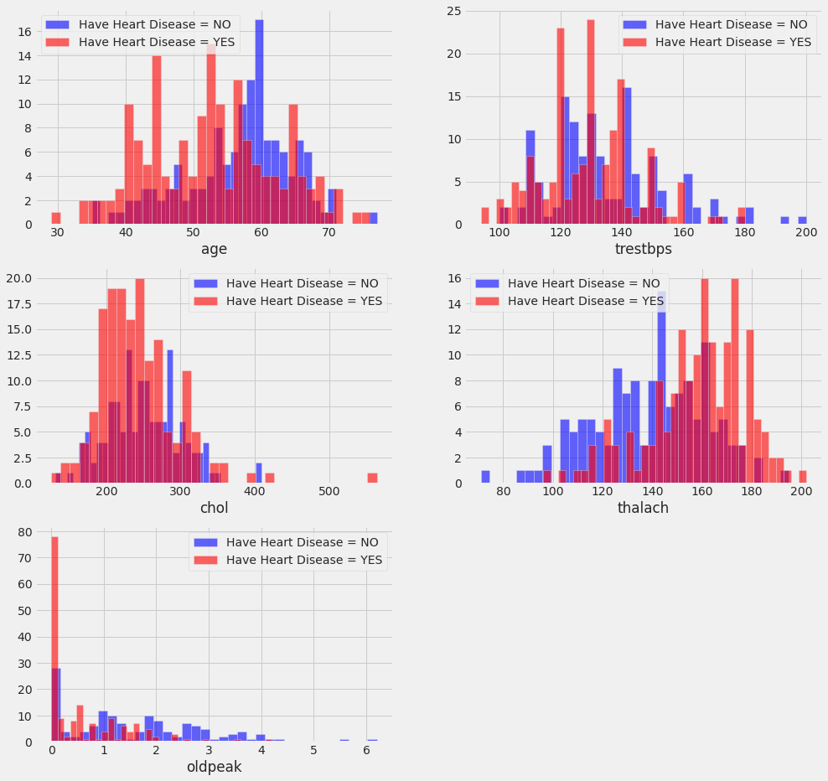
MODEL IMPLEMENTATION

Slide 10
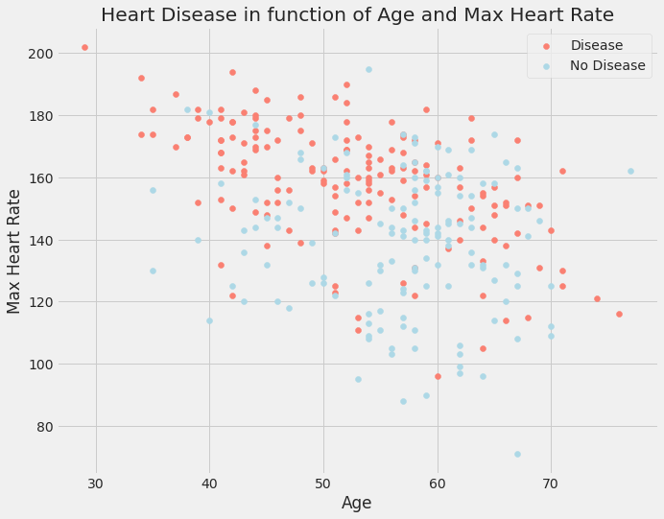

Slide 11
CORRELATION MATRIX
On a data-set with many attributes, the set of correlation values between pairs of its attributes form a matrix which is called a correlation matrix.
The correlation matrix is a symmetrical matrix with all diagonal elements equal to +1.

Slide 12
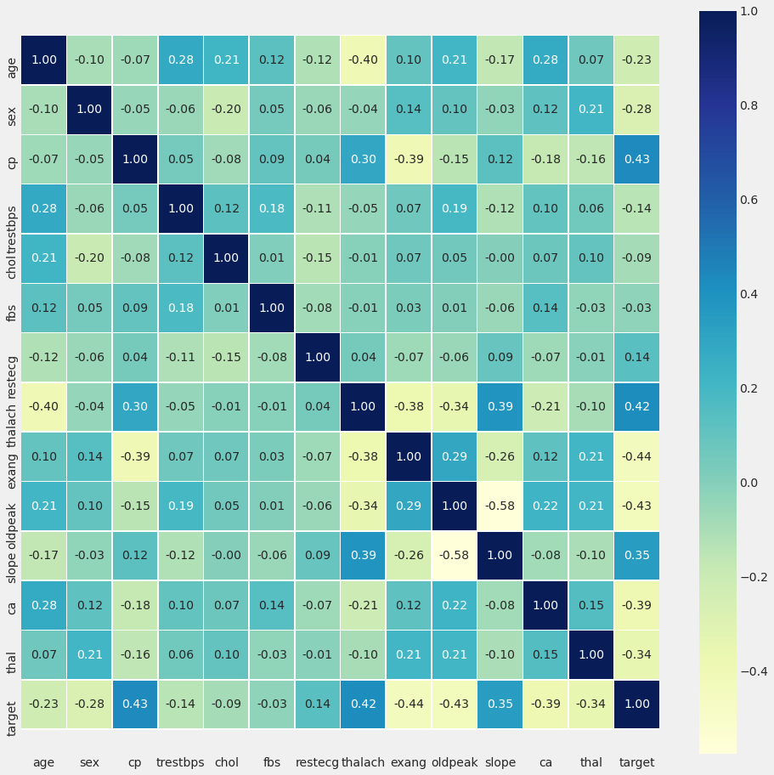

Slide 13
ADVANTAGES
The technology here used is machine learning(MI) concept along with the Ardunio and Heart/Pulse Rate Sensor.
The proposed system can save time and effort,improving the health care of patients.

Slide 14
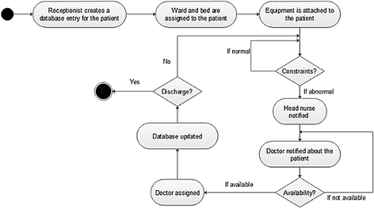
real – case scenario

Slide 15
CONCLUSION
In this project, we aim to monitor the health parameters of the patients efficiently and use the monitored data combined with their medical history to predict whether the patient may suffer from HD ( Heart Disease) or not.
This project mainly aims to predict the heart disease and not for detection.

Slide 16


